Slide 1


CS 153: Concepts of Compiler Design September 24 Class Meeting
Department of Computer Science San Jose State University Fall 2020 Instructor: Ron Mak
www.cs.sjsu.edu/~mak

Slide 2
More Assignment #4 Tips
In the visit methods for expressions, method visitChildren() might not return an object with the datatype that you expect.
Use visit() instead to make a direct visit.
Example: In method visitSimpleExpression():
Method visitFactor() can return an integer number, a real number, or a string.
Use runtime type identification typeof() to see what type of value is returned.
Object value = visit(ctx.term().factor().number());

Slide 3
Reminder: Syntax and Semantics
Syntax refers to the grammar rules of the of a source language.
The rules prescribe the proper form of its programs.
The parser “knows” the grammar.
Rules can be described by syntax diagrams.
Syntax checking
Does this sequence of tokens follow the syntax rules?
Performed by the frontend parser.

Slide 4
Syntax and Semantics, cont’d
Semantics refers to the meaning of syntactically correct token sequences of the source language.
Example: Certain sequences of tokens constitute an IF statement according to the language’s grammar.
The semantics of the statement determine
How the interpreter will execute the statement, or
How the compiler or converter will generate object code for the statement.

Slide 5
Syntax and Semantics, cont’d
Semantic actions by the frontend parser based on the meanings of statements and expressions:
Building proper parse trees.
Building symbol tables.
Type checking.
The parse trees encode type checking and operator precedence in their structures.

Slide 6
Syntax and Semantics, cont’d
Semantic actions in the back end:
Interpreter: The executor runs the program and performs actions according to the meanings of the statements and expressions.
Compiler and converter: The code generator emits object code that reflects the meanings of the statements and expressions.

Slide 7
Multipass Compilers
A compiler can make multiple passes.
A pass involves going through the source program, either in the original text form or as a parse tree.
During each pass, the compiler performs operations that are relevant to that pass.
Pass 1 (frontend syntax)
Read the original source program text.
Verify that the source program is syntactically correct.
Build the parse tree.
Done by ANTLR-generated code.

Slide 8
Multipass Compilers, cont’d
Pass 2 (frontend semantics)
Visit the parse tree.
Enter identifier and type information into the symbol table.
Perform type checking.
Add additional information to the parse tree nodes.
Pass 3 (backend semantics)
Revisit the parse tree, now with additional information in the tree nodes.
Execute the source program or generate code.

Slide 9
Declarations and the Symbol Table
Identifiers from Pascal declarations that we will enter into a symbol table, names of:
constants
types
enumeration values
record fields
variables
Information from parsing type specifications:
simple types
array types
record types
Notes:
START HERE.

Slide 10
Type Specification Attributes
Each type specification has certain attributes depending on its form.
Type form
Type specification attributes
Scalar
None
Enumeration
List of enumeration constant identifiers
Subrange
Base type
Minimum value
Maximum value
Array
Index type
Element type
Element count
Record
A separate symbol table for the field identifiers

Slide 11
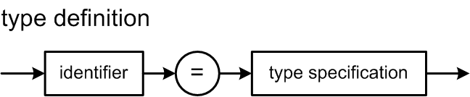
Review: Type Definitions
Sample type definitions:
TYPE
e = (alpha, beta, gamma);
sr = alpha..beta;
ar = ARRAY [1..10] OF sr;
rec = RECORD
x, y : integer
END;
How can we represent type specification information in our symbol table
and associate the correct type specification with an identifier?

Slide 12
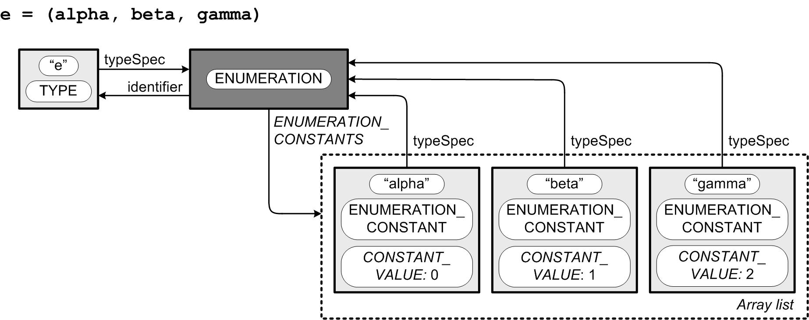
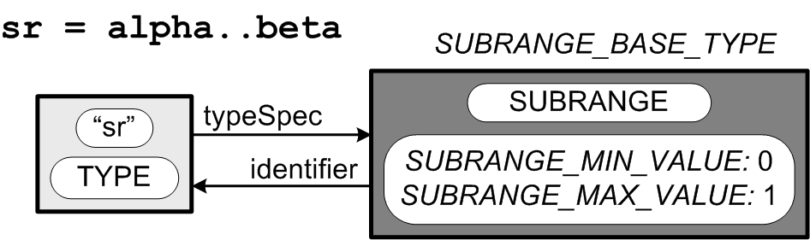
Type Definition Structures
type specification
(class Typespec)
symbol table entry
(class SymTabEntry)
typespec
typespec
constants
typespec
typespec
symbol table entry
(class SymTabEntry)
ArrayList<SymtabEntry>
constants;
baseType
Each symbol table entry has a
pointer to a type specification.
Each type specification of a
named type has a pointer to the
type identifier’s symbol table entry.
typespec
typespec

Slide 13
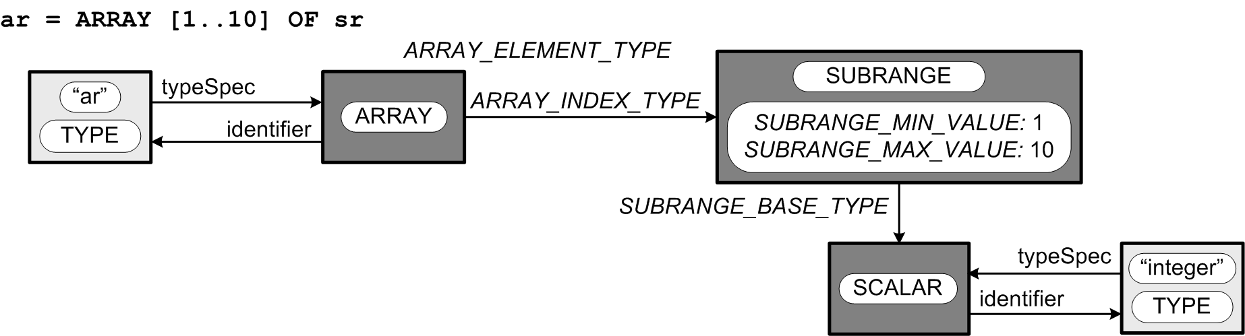
Type Definition Structures, cont’d
When it is parsing declarations,
the parser builds
type specification structures.
When it is parsing executable statements,
the parser builds parse trees.
SUBRANGE_BASE_TYPE
baseType
typespec
typespec
Unnamed type
elementType
typespec
indexType
minValue: 1
maxValue: 10
Is there an unnamed type?
baseType
typespec

Slide 14
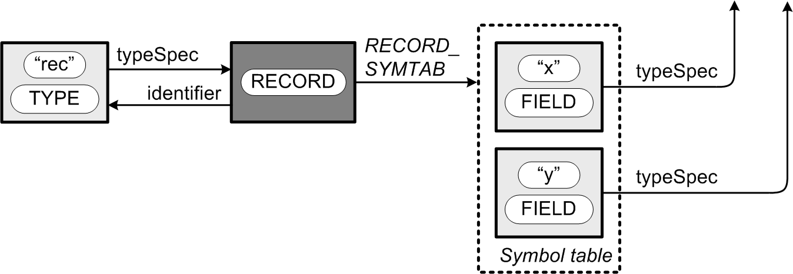
Type Definition Structures, cont’d
elementType
ARRAY_ELMT_TYPE
indexType
minValue: 1
maxValue: 10
baseType
typespec
rec = RECORD x,y : integer END
typespec
symtab
typespec
Each record type has its own
symbol table to contain
its record field identifiers.
typespec

Slide 15
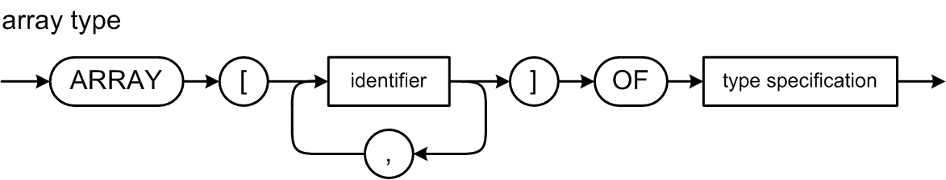
Pascal Array Type
elementType
typespec
indexType
minValue: 1
maxValue: 10
baseType
typespec

Slide 16
Pascal Multidimensional Array
These definitions are all equivalent:
dim3 = ARRAY [1..3, 'a'..'z', boolean] OF real;
dim3 = ARRAY [1..3] OF ARRAY ['a'..'z'] OF ARRAY [boolean] OF real;
dim3 = ARRAY [1..3, 'a'..'z'] OF ARRAY [boolean] OF real;
dim3 = ARRAY [1..3] OF ARRAY ['a'..'z, boolean] OF real;
Therefore, they must all generate the same type specification structure.

Slide 17
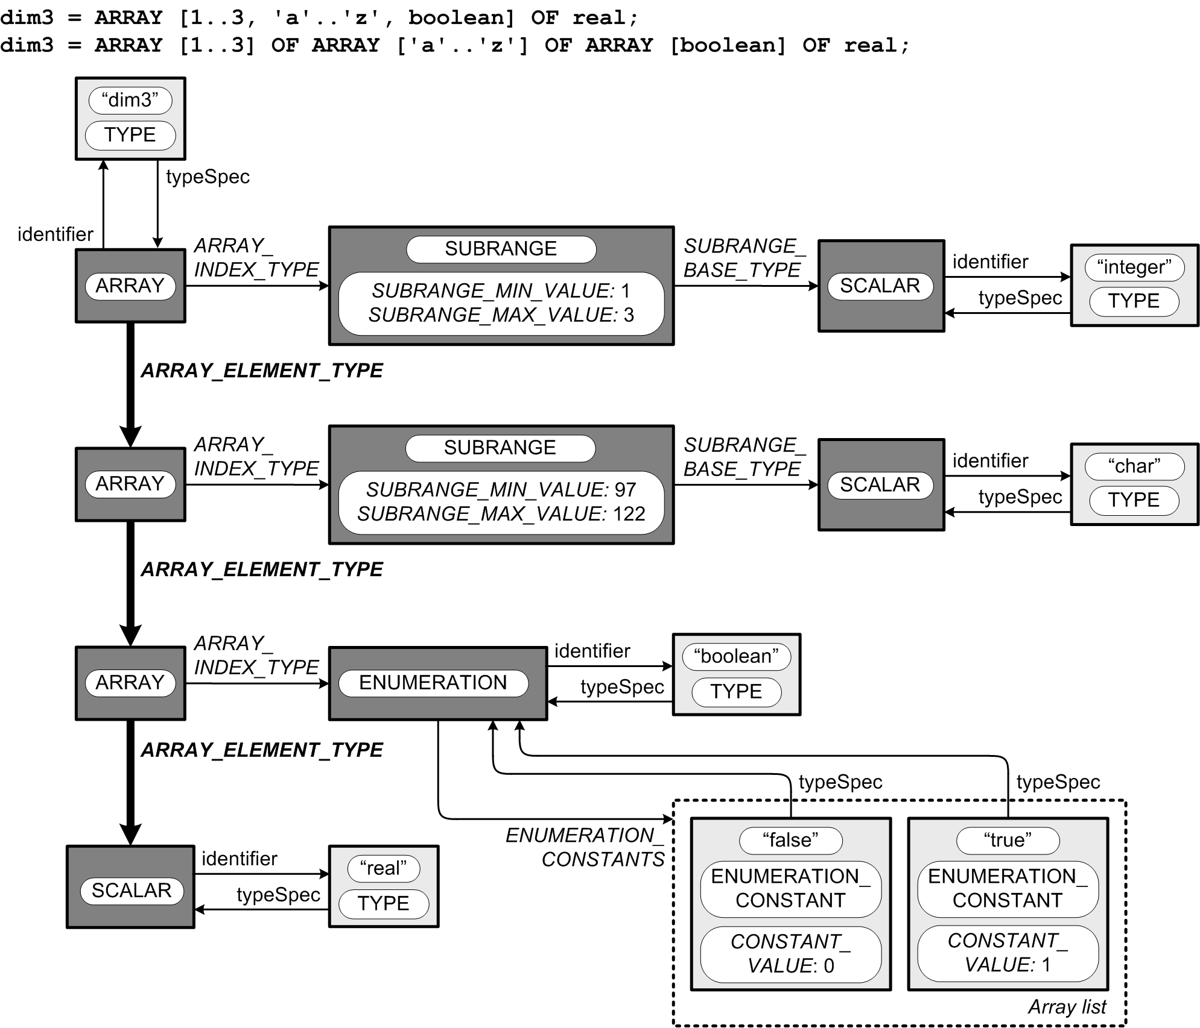
Pascal Multidimensional Array
typespec
indexType
baseType
minValue: 1
maxValue: 3
typespec
elementType
The first two
element types
are arrays,
and the third
element type
is real scalar.
indexType
baseType
minValue: 97
maxValue: 122
typespec
elementType
indexType
typespec
elementType
typespec
typespec
constants
typespec
constants
constants

Slide 18
Predefined Scalar Types
package intermediate.symtab;
...
public class Predefined
{
// Predefined types.
public static Typespec integerType;
public static Typespec realType;
public static Typespec booleanType;
public static Typespec charType;
public static Typespec stringType;
public static Typespec undefinedType;
// Predefined identifiers.
public static SymtabEntry integerId;
public static SymtabEntry realId;
public static SymtabEntry booleanId;
public static SymtabEntry charId;
public static SymtabEntry stringId;
public static SymtabEntry falseId;
public static SymtabEntry trueId;
public static SymtabEntry readId;
public static SymtabEntry readlnId;
public static SymtabEntry writeId;
public static SymtabEntry writelnId;
...
intermediate.symtab.Predefined

Slide 19
Predefined Scalar Types, cont’d
private static void initializeTypes(SymtabStack symTabStack)
{
// Type integer.
integerId = symTabStack.enterLocal("integer", TYPE);
integerType = new Typespec(SCALAR);
integerType.setIdentifier(integerId);
integerId.setType(integerType);
// Type real.
realId = symTabStack.enterLocal("real", TYPE);
realType = new Typespec(SCALAR);
realType.setIdentifier(realId);
realId.setType(realType);
// Type boolean.
booleanId = symTabStack.enterLocal("boolean", TYPE);
booleanType = new Typespec(ENUMERATION);
booleanType.setIdentifier(booleanId);
booleanId.setType(booleanType);
...
}
intermediate.symtab.Predefined

Slide 20
Predefined Scalar Types, cont’d
private static void initializeConstants(SymtabStack symTabStack)
{
// Boolean enumeration constant false.
falseId = symTabStack.enterLocal("false", ENUMERATION_CONSTANT);
falseId.setType(booleanType);
falseId.setValue(0);
// Boolean enumeration constant true.
trueId = symTabStack.enterLocal("true", ENUMERATION_CONSTANT);
trueId.setType(booleanType);
trueId.setValue(1);
// Add false and true to the boolean enumeration type.
ArrayList<SymtabEntry> constants = booleanType.getEnumerationConstants();
constants.add(falseId);
constants.add(trueId);
}

Slide 21
Type Checking
Another Pass 2 semantics operation while visiting the parse tree.
Check for
operands are type-compatible with their operands
values are assignment-compatible with their targets
values are comparison-compatible
Semantic errors
undeclared identifiers
type incompatibility

Slide 22
Type Checking
Ensure that the types of the operands are type-compatible with their operator.
Example: You can only perform an integer division with the DIV operator and integer operands.
Example: The relational operators AND and OR can only be used with boolean operands.
Ensure that a value being assigned to a variable is assignment-compatible with the variable.
Example: You cannot assign a string value to an integer variable.

Slide 23
Assignment and Comparison Compatible
In Pascal, a value is assignment-compatible with a target variable if:
both have the same type
the target is real and the value is integer
they are both strings
Two values are comparison-compatible (they can be compared with relational operators) if:
both have the same type
one is integer and the other is real
they are both strings

Slide 24
Class TypeChecker
Static boolean methods for type checking:
isInteger()
areBothInteger()
areBothString()
isReal()
isIntegerOrReal()
isAtLeastOneReal()
isBoolean()
areBothBoolean()
isChar()
isString()
areAssignmentCompatible()
areComparisonCompatible()
intermediate.type.TypeChecker

Slide 25
Type Checking Expressions
Pass 2 must perform type checking of every expression as part of its semantic actions.
Add type checking to the appropriate Pass 2 visit methods.
Flag type errors similarly to syntax errors.

Slide 26
Pass 2 Visit Methods for Type Definitions
Pass 2 visits the parse tree to build the type definition structures and enter them into the symbol table.
visitTypeDefinition()
visitTypeIdentifier()
visitSimpleTypespec()
visitArrayTypespec()
visitRecordTypespec()
visitTypeIdentifierTypespec()
visitEnumerationTypespec()
visitSubrangeTypespec()

Slide 27
New Fields for Parse Tree Nodes
We want the Pass 2 visit of the parse tree to leave useful information in the tree nodes for use by Pass 3 when the latter pass revisits the parse tree.
Nodes for identifiers: Add an entry field to point to the symbol table entry of the identifier.
Nodes where datatype matters: Add a type field to point to a type specification structure.
Nodes for constants: Add a value field to hold the constant value.

Slide 28
Grammar Pcl6.g4
constantIdentifier locals [ Typespec type = null, SymtabEntry entry = null ]
: IDENTIFIER ;
constant locals [ Typespec type = null, Object value = null ]
: sign? ( IDENTIFIER | unsignedNumber )
| characterConstant
| stringConstant
;
typesPart : TYPE typeDefinitionsList ;
typeDefinitionsList : typeDefinition ( ';' typeDefinition )* ;
typeDefinition : typeIdentifier '=' typeSpecification ;
typeIdentifier locals [ Typespec type = null, SymtabEntry entry = null ]
: IDENTIFIER ;
typeSpecification locals [ Typespec type = null ]
: simpleType # simpleTypespec
| arrayType # arrayTypespec
| recordType # recordTypespec
;

Slide 29
Grammar Pcl6.g4, cont’d
variableIdentifier locals [ Typespec type = null, SymtabEntry entry = null ]
: IDENTIFIER ;
expression locals [ Typespec type = null ]
: simpleExpression (relOp simpleExpression)? ;
simpleExpression locals [ Typespec type = null ]
: sign? term (addOp term)* ;
term locals [ Typespec type = null ]
: factor (mulOp factor)* ;
factor locals [ Typespec type = null ]
: variable # variableFactor
| number # numberFactor
| characterConstant # characterFactor
| stringConstant # stringFactor
| NOT factor # notFactor
| '(' expression ')' # parenthesizedFactor
;
variable locals [ Typespec type = null, SymtabEntry entry = null ]
: IDENTIFIER ;

